Slide 1
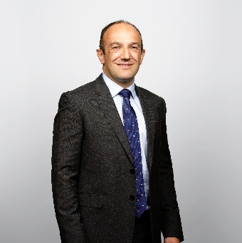
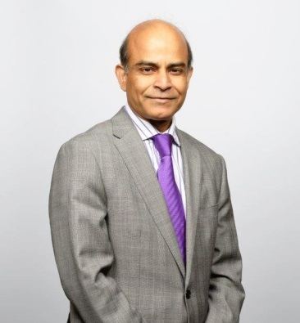
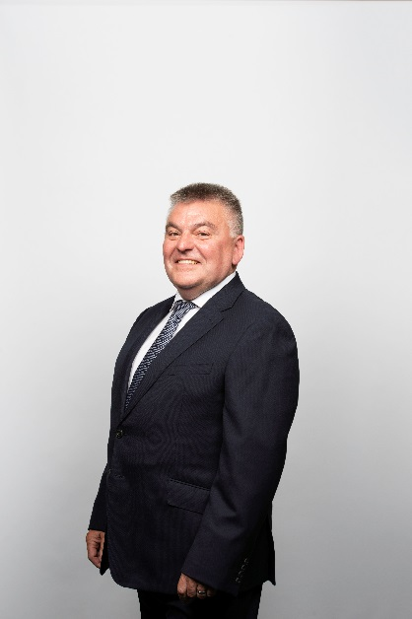
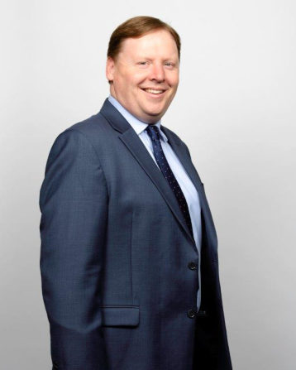
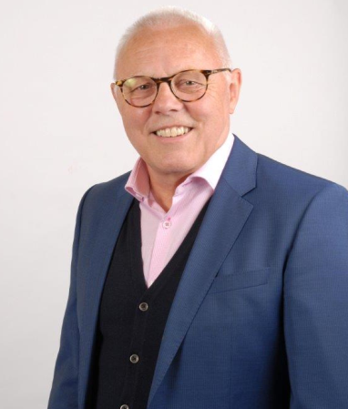
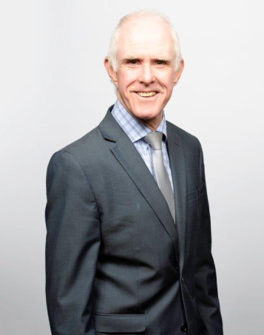
Enda Scott
Managing Director
Medical Devices
Debashis Dasgupta
Managing Director
Pharma
David Rodgers
Medical Devices Business Director Ireland
Pat Tehan
Sales Director
Pharma Ireland
Richard Webb
Medical Devices Business Director UK
David Wright
Director, New Product Development, Pharma

