Slide 1
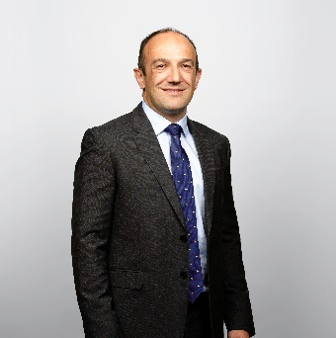
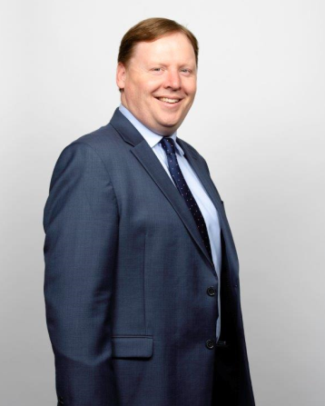
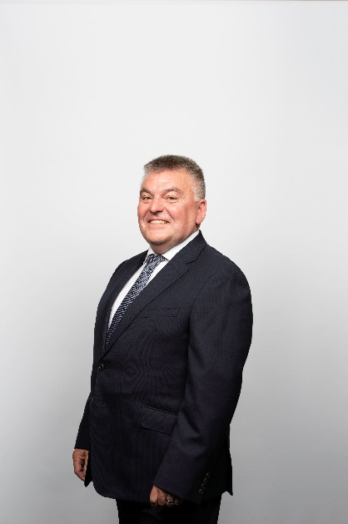
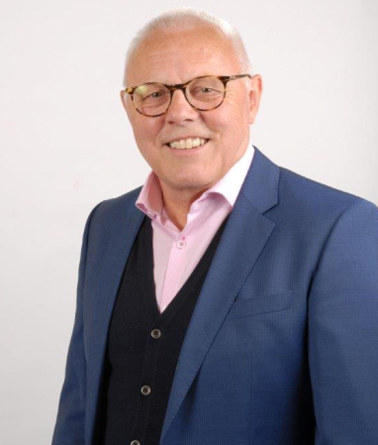
Enda Scott
Managing Director
Medical Devices
Patrick Tehan
Sales Director
Pharma Ireland
David Rodgers
Medical Devices Business Director Ireland
Richard Webb
Medical Devices Business Director UK

